Slide 1
Module2_Heuristic Search Strategies
Reference: Russell, S. and Norvig, P. Artificial Intelligence - A Modern Approach, 4th edition, Prentice Hall, 2020-Chapter 3, section 3.5

Slide 2
Heuristic Technique
A heuristic or heuristic technique, is any approach to problem solving or self-discovery that employs a practical method that is not guaranteed to be optimal, perfect, or rational, but is nevertheless sufficient for reaching an immediate, short-term goal or approximation.
Where ever finding an optimal solution is impossible or impractical, heuristic methods can be used to speed up the process of finding a satisfactory solution.

Slide 3
Heuristic Technique
In mathematical optimization and computer science, heuristic is a technique designed for solving a problem
more quickly when classic methods are too slow or for finding an approximate solution when classic methods fail to find any exact solution.
This is achieved by trading optimality, completeness, accuracy, or precision for speed.
A heuristic function (a heuristic), is a function that ranks alternatives in search algorithms at each branching step based on available information to decide which branch to follow.

Slide 4
Informed (Heuristic) Search Strategies
Informed search algorithms use domain knowledge.
In an informed search, problem information is available which can guide the search.
Can find a solution more efficiently than an uninformed search strategy.
It is also called a Heuristic search in which it might not always be guaranteed for best solutions but guaranteed to find a good solution in reasonable time.

Slide 5
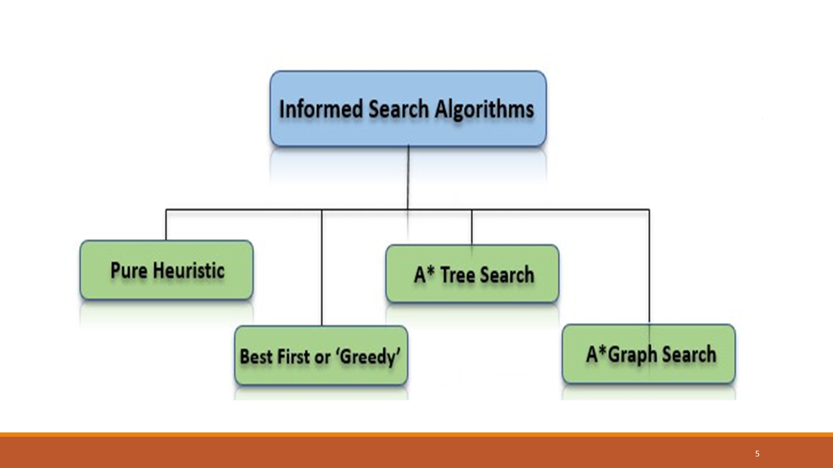
In the informed search we will discuss two main algorithms which are given below:
Best First Search Algorithm(Greedy search)
A* Search Algorithm
In the informed search we will discuss two main algorithms which are given below:
Best First Search Algorithm(Greedy search)
A* Search Algorithm

Slide 6
Informed (Heuristic) Search Strategies
Informed search strategy uses domain-specific hints about the location of goals.
The hints come in the form of a heuristic function, denoted by h(n).
h(n) = estimated cost of the cheapest path from the state at node n to a goal state.
For example, in route-finding problems, we can estimate the distance from the current state to a goal by computing the straight-line distance on the map between the two points.

Slide 7
Best-first search
Best-first search is a class of search algorithms, which explore a graph by expanding the most promising node chosen according to a specified rule.
Judea Pearl described the best-first search as estimating the promise of node n by a “heuristic evaluation function f(n)”
which, in general, may depend on
the description of n,
the description of the goal,
the information gathered by the search up to that point,
and most importantly, on any extra knowledge about the problem domain.

Slide 8
Best-first search
Some authors have used "best-first search" to refer specifically to a search with a heuristic that attempts to predict how close the end of a path is to a solution (or, goal), so that paths which are judged to be closer to a solution (or, goal) are extended first.
This specific type of search is called greedy best-first search or pure heuristic search.

Slide 9
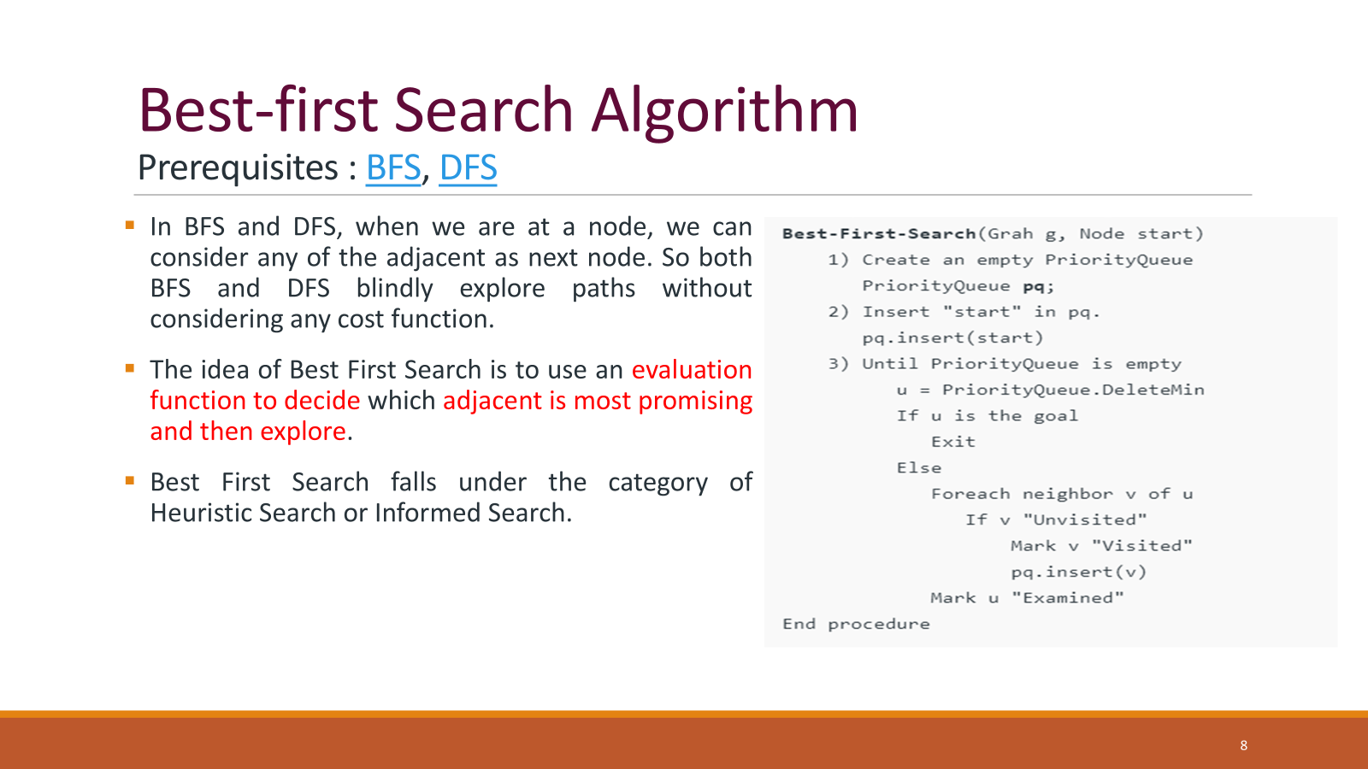

Slide 10
Best-first search
Step 1: Place the starting node into the OPEN list.
Step 2: If the OPEN list is empty, Stop and return failure.
Step 3: Remove the node n, from the OPEN list which has the lowest value of h(n), and places it in the CLOSED list.
Step 4: Expand the node n, and generate the successors of node n.
Step 5: Check each successor of node n, and find whether any node is a goal node or not. If any successor node is goal node, then return success and terminate the search, else proceed to Step 6.
Step 6: For each successor node, algorithm checks for evaluation function f(n), and then check if the node has been in either OPEN or CLOSED list. If the node has not been in both list, then add it to the OPEN list.
Step 7: Return to Step 2.

Slide 11
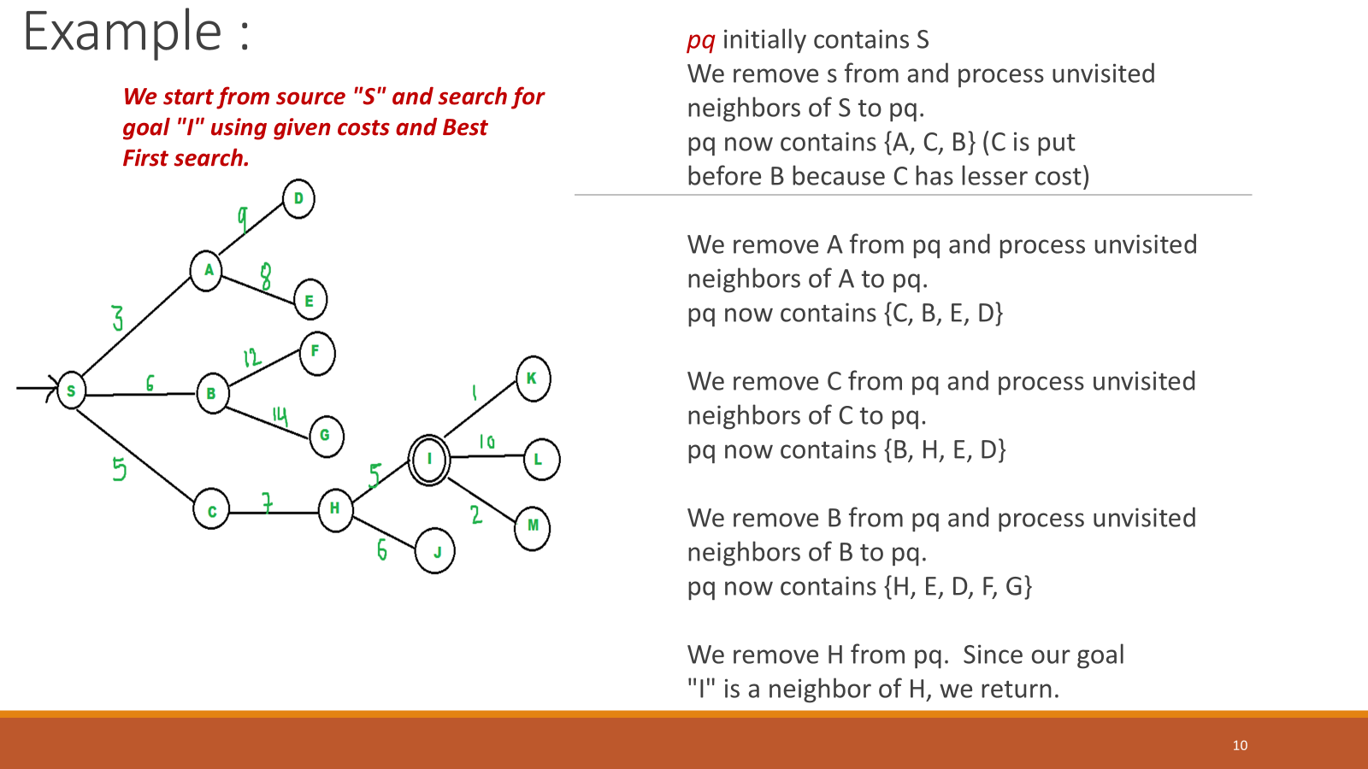

Slide 12
Advantages and Disadvantages
Advantages:
Best first search can switch between BFS and DFS by gaining the advantages of both the algorithms.
This algorithm is more efficient than BFS and DFS algorithms.
Disadvantages:
It can behave as an unguided depth-first search in the worst case scenario.
It can get stuck in a loop as DFS.
This algorithm is not optimal.

Slide 13
Analysis
Worst case time complexity for Best First Search is O(n * Log n) where n is number of nodes.
In worst case, we may have to visit all nodes before we reach goal. Note that priority queue is implemented using Min(or Max) Heap, and insert and remove operations take O(log n) time.
Performance of the algorithm depends on how well the cost or evaluation function is designed.

Slide 14
Greedy best-first search
Greedy best-first search is a form of best-first search that expands first the node with the lowest h(n) value
the node that appears to be closest to the goal—on the grounds that this is likely to lead to a solution quickly.
So the evaluation function is f(n) =h(n).
h(n) = estimated cost of the cheapest path from the state at node n to a goal state.
Example: Let us see how this works for route-finding problems in Romania;
we use the straight-line distance heuristic, which we will call h_{SLD}
If the goal is Bucharest, we need to know the straight-line distances to Bucharest.
Note: The values of h_{SLD} cannot be computed from the problem description itself (that is, the ACTIONS and RESULT functions).
It takes a certain amount of world knowledge to know that is correlated with actual road distances and is, therefore, a useful heuristic.

Slide 15
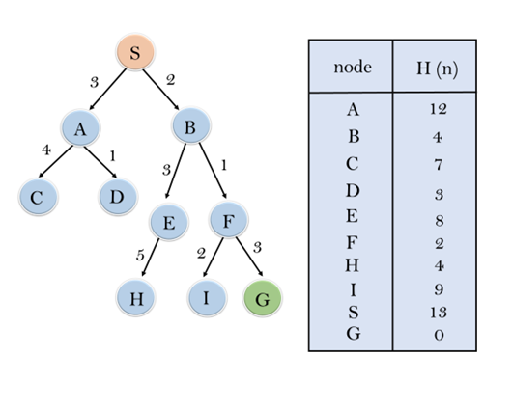
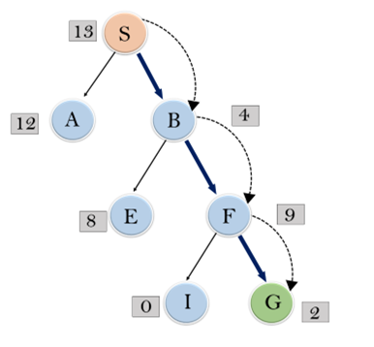
Example :
Consider the below search problem, and we will traverse it using greedy best-first search. At each iteration, each node is expanded using evaluation function f(n)=h(n) , which is given in the below table.

Slide 16
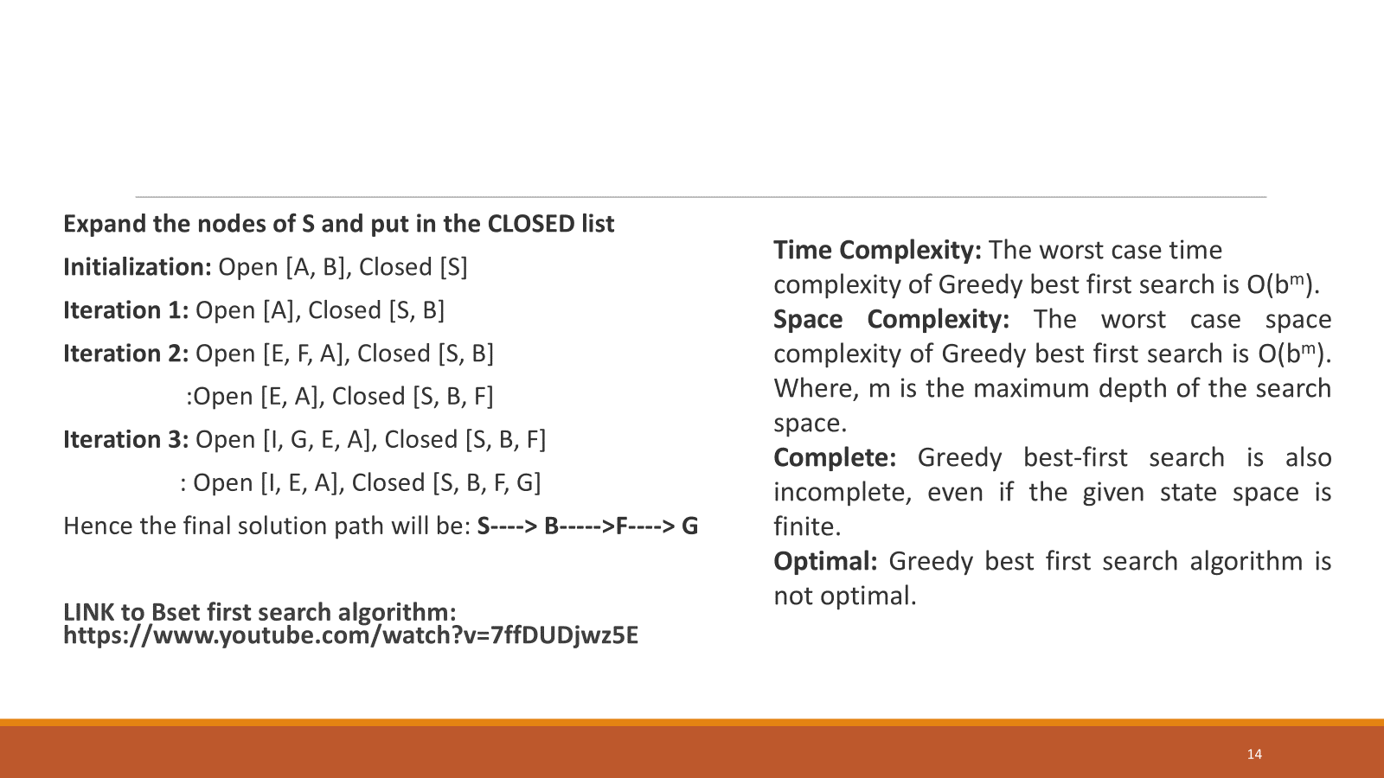

Slide 17
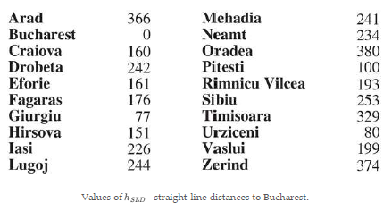
Greedy best-first search
Example: h(n)

Slide 18
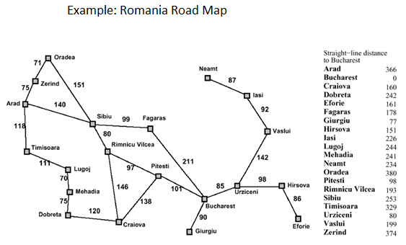
Greedy best-first search
Example:

Slide 19
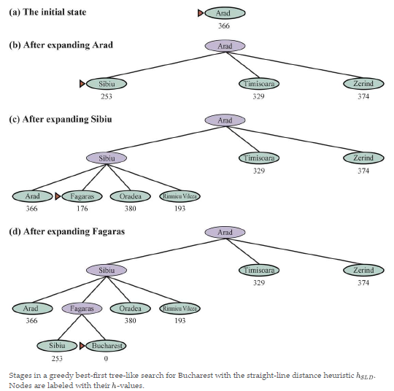
Greedy best-first search

Slide 20
Greedy best-first search
Shows the progress of a greedy best-first search using h_{SLD} to find a path from Arad to Bucharest.
The first node to be expanded from Arad will be Sibiu because the heuristic says it is closer to Bucharest than is either Zerind or Timisoara.
The next node to be expanded will be Fagaras because it is now closest according to the heuristic. Fagaras in turn generates Bucharest, which is the goal.
For this particular problem, greedy best-first search using h_{SLD} finds a solution without ever expanding a node that is not on the solution path.
The solution it found does not have optimal cost, however: the path via Sibiu and Fagaras to Bucharest is 32 miles longer than the path through Rimnicu Vilcea and Pitesti.
This is why the algorithm is called “greedy”—on each iteration it tries to get as close to a goal as it can, but greediness can lead to worse results than being careful.

Slide 21
Greedy best-first search - Steps
Create two empty lists namely open and closed list.
Start from the initial node and add it to the ordered open list
Repeat until the goal node or endpoint is reached
If the open list is empty exit the loop and return False, which says that the final node cannot be reached
Select the top node/goal node in the open list and move it to the closed list while keeping track of the parent node
If the node removed is the endpoint node return True , meaning a path has been found and moving the node to the closed list
However if it is not the endpoint node then list down all the neighboring nodes of it and add them to the open list
According to the evaluation function re order the nodes.

Slide 22
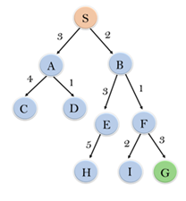
Greedy best-first search
Example: Start node is ‘S’ and goal/end node is ‘G’

Slide 23
Greedy best-first search
Create two empty lists namely open and closed list.
Start from the initial node and add it to the ordered open list
Repeat until the goal node or endpoint is reached
If the open list is empty exit the loop and return False, which says that the final node cannot be reached
Select the top node/goal node in the open list and move it to the closed list while keeping track of the parent node
If the node removed is the endpoint node return True , meaning a path has been found and moving the node to the closed list
However if it is not the endpoint node then list down all the neighboring nodes of it and add them to the open list
According to the evaluation function re order the nodes.
Example: Start node is ‘S’ and goal/end node is ‘G’

Slide 24
Greedy best-first search
Example: Start node is ‘S’ and goal/end node is ‘G’
Initially only node S is present in the open list and closed is empty. Open : [S] Closed: []
Iteration 1: Remove node S and move it to the closed list and the neighbor nodes of S are added to open Open: [A,B], reordered as
Open: [B,A] Closed: [S]
Iteration 2: Remove node B from open and move to the closed list.
Neighboring nodes of B are pushed
to the open list. Open: [E,F,A], reordered as
Open: [F,A,E] Closed: [S,B]
Iteration 3: Node F is removed and added to the closed list. Neighbors of F are added to the open list. Open: [I,G,E,A] Closed: [S,B,F]
Iteration 4: we have our target node in the open list hence we select that and move it to the closed list. We stop iterating further. Open: [I,E,A] Closed: [S,B,F,G]
The path is S->B->F->G

Slide 25
Greedy best-first search
Greedy best-first graph search is complete in finite state spaces.
The worst-case time and space complexity is O(|V|)
With a good heuristic function, however, the complexity can be reduced substantially, on certain problems reaching O(bm)

Slide 26
A* heuristic search
A* is an informed search strategy that uses best-first search technique.
It is formulated in terms of weighted graphs.
Starting from a specific starting node of a graph, it aims to find a path to the given goal node having the smallest cost (least distance travelled, shortest time, etc.).
It does this by maintaining a tree of paths originating at the start node and extending those paths one edge at a time until its termination criterion is satisfied.

Slide 27
A* heuristic search
The most common informed search algorithm is A* search (pronounced “A-star search”), a best-first search that uses the evaluation function
f(n) = g(n) + h(n)
g(n) is the path cost from the initial state to node n
h(n) is the estimated cost of the shortest path from n to a goal state
f(n) = estimated cost of the best path that continues from n to a goal.

Slide 28
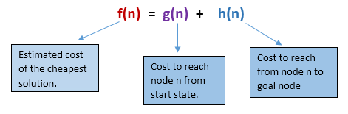
A* heuristic search
At each iteration, A* needs to determine which of its paths to extend.
It does so based on the cost of the path and an estimate of the cost required to extend the path all the way to the goal.
Specifically, A* selects the path that minimizes f(n)=g(n)+h(n)
where n is the next node on the path
g(n) is the cost of the path from the start node to n
h(n) is a heuristic function that estimates the cost of the cheapest path from n to the goal.
A* terminates when the path it chooses to extend is a path from start to goal or if there are no paths eligible to be extended.

Slide 29
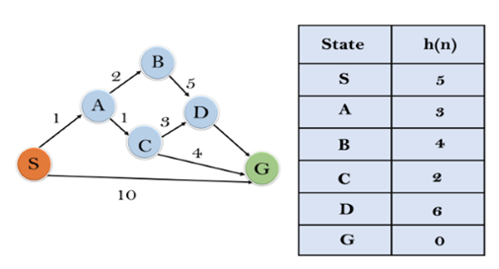
A* heuristic search
Example: S is the starting node and G is the goal node.

Slide 30
A* heuristic search
Example continued:
Initialization: {(S, 5)}
Iteration1: {(S--> A, 4), (S-->G, 10)}
Iteration2: {(S--> A-->C, 4), (S--> A-->B, 7), (S-->G, 10)}
Iteration3: {(S--> A-->C--->G, 6), (S--> A-->C--->D, 11), (S--> A-->B, 7), (S-->G, 10)}
Iteration 4 will give the final result, as
S--->A--->C--->G
provides the optimal path with cost 6.

Slide 31
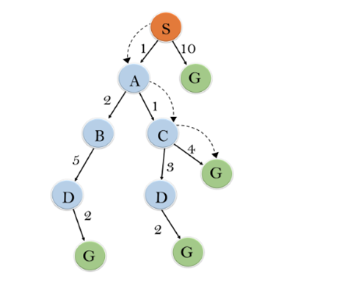
A* heuristic search
Example continued:

Slide 32
It is important to note that-
A* Algorithm is one of the best path finding algorithms.
But it does not produce the shortest path always.
This is because it heavily depends on heuristics.

Slide 33
A* search Example
Consider the progress of an A* search with the goal of reaching Bucharest.
The values of are computed from the action costs .
Notice that Bucharest first appears on the frontier at step (e), but it is not selected for expansion (and thus not detected as a solution) because as it is not the lowest-cost node on the frontier—that would be Pitesti, at Another way to say this is that there might be a solution through Pitesti whose cost is as low as 417, so the algorithm will not settle for a solution that costs 450.
At step (f), a different path to Bucharest is now the lowest-cost node, at so it is selected and detected as the optimal solution.

Slide 34
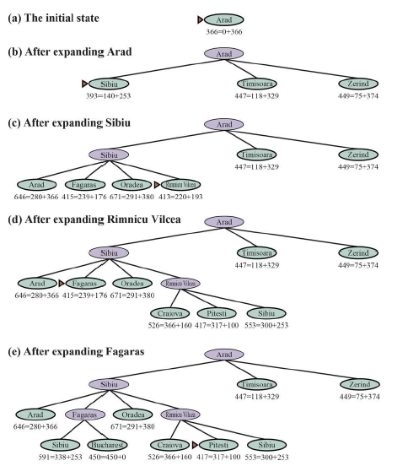
A* search Example

Slide 35
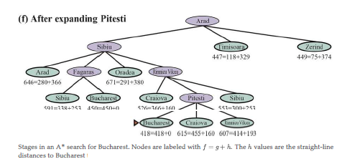
A* search Example
Example

Slide 36
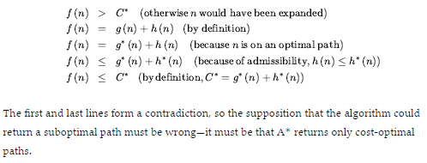
A* Search properties
A* search is complete.
Whether A* is cost-optimal depends on certain properties of the heuristic.
A key property is admissibility: an admissible heuristic is one that never overestimates the cost to reach a goal. (An admissible heuristic is therefore optimistic.)
With an admissible heuristic, A* is cost-optimal, which we can show with a proof by contradiction.
Suppose the optimal path has cost C∗ but the algorithm returns a path with Cost C > C∗.
Then there must be some node n which is on the optimal path and is unexpanded (because if all the nodes on the optimal path had been expanded, then we would have returned that optimal solution).
So then, using the notation to g∗(n) mean the cost of the optimal path from the start to n and h∗(n) to mean the cost of the optimal path from n to the nearest goal, we have:

Slide 37
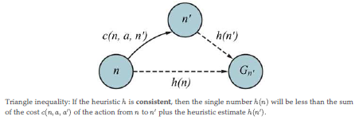
A* Search properties
i.e.
f (n) > C∗ (otherwise n would have been expanded)
f (n) = g (n) + h (n) (by definition)
f (n) = g∗ (n) + h (n) (because n is on an optimal path)
f (n) ≤ g∗ (n) + h∗ (n) (because of admissibility, h (n) ≤ h∗ (n))
f (n) ≤ C∗ (by definition,C∗ = g∗ (n) + h∗ (n))
The first and last lines form a contradiction, so the supposition that the algorithm could return a suboptimal path must be wrong—it must be that A* returns only cost-optimal paths.
A slightly stronger property is called Consistency(Monotonicity). A heuristic is consistent if, for every node n and every successor n’ of n generated by an action a we have:
h(n) ≤ c(n, a, n′) + h(n′).
This is a form of the triangle inequality, which stipulates that a side of a triangle cannot be longer than the sum of the other two sides An example of a consistent heuristic is the straight-line distance that we used in getting to Bucharest.

Slide 38
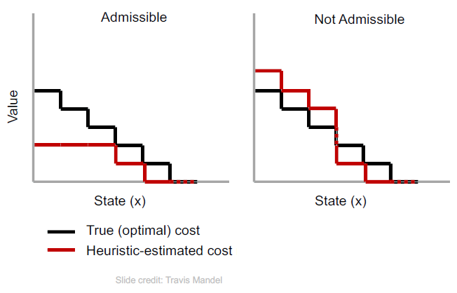
A* Search properties
If h(n) is admissible and consistent(monotonic) then A* is optimal

Slide 39
A* Search properties
With an inadmissible heuristic, A* may or may not be cost-optimal.
Here are two cases :
i)If there is even one cost-optimal path on which (h(n) is admissible for all nodes on the path, then that path will be found, no matter what the heuristic says for states off the path.
ii) If the optimal solution has cost C* and the second-best has cost C₂ and if h(n) overestimates some costs, but never by more than C₂ - C* then A* is guaranteed to return cost-optimal solutions.

Slide 40
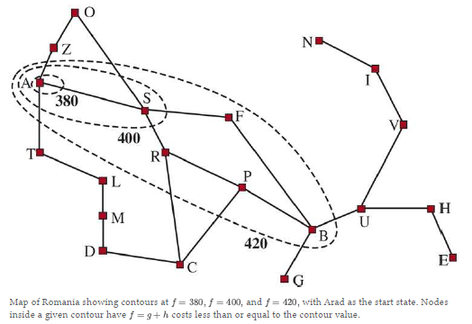
Search contours
A useful way to visualize a search is to draw contours in the state space.
Inside the contour labelled 400, all nodes have f(n) = g(n) + h(n) ≤ 400,and so on.
Because A* expands the frontier node of lowest -cost, we can see that an A* search fans out from the start node, adding nodes in concentric bands of increasing -cost.

Slide 41
Search contours
With A* search using a good heuristic, the bands will stretch toward a goal state and become more narrowly focused around an optimal path.
As we extend a path, the costs are monotonic: the path cost always increases as you go along a path, because action costs are always positive.
The path’s cost will be monotonically increasing if and only if h(n) ≤ c(n, a, n′) + h(n′).
i.e If and only if the heuristic is consistent.

Slide 42
A* Search properties
If C* is the cost of the optimal solution path, then we can say the following:
A* expands all nodes that can be reached from the initial state on a path where every node on the path has f(n) < C* . We say these are surely expanded nodes.
A* might then expand some of the nodes right on the “goal contour” before selecting a goal node.
A* expands no nodes with f(n) > C*
A* with a consistent heuristic is optimally efficient in the sense that any algorithm that extends search paths from the initial state, and uses the same heuristic information, must expand all nodes that are surely expanded by A*
A* is efficient because it prunes away search tree nodes that are not necessary for finding an optimal solution.

Slide 43
A* Search properties
The concept of pruning—eliminating possibilities from consideration without having to examine them—is important for many areas of AI.
A* search is complete, cost-optimal, and optimally efficient among all such algorithms is rather satisfying.
Unfortunately, it does not mean that A* is the answer to all our searching needs.
The catch is that for many problems, the number of nodes expanded can be exponential in the length of the solution.

Slide 44
Satisficing search: Inadmissible heuristics and weighted A*
A* search has many good qualities, but it expands a lot of nodes.
We can explore fewer nodes (taking less time and space) if we are willing to accept solutions that are suboptimal, but are “good enough”—what we call satisficing solutions.
If we allow A* search to use an inadmissible heuristic—one that may overestimate—then we risk missing the optimal solution, but the heuristic can potentially be more accurate, thereby reducing the number of nodes expanded.
For example, road engineers know the concept of a detour index, which is a multiplier applied to the straight-line distance to account for the typical curvature of roads.
A detour index of 1.3 means that if two cities are 10 miles apart in straight-line distance, a good estimate of the best path between them is 13 miles.
For most localities, the detour index ranges between 1.2 and 1.6.
We can apply this idea to any problem, not just ones involving roads, with an approach called weighted A* search

Slide 45
Weighted A*search
We can apply this idea to any problem, not just ones involving roads, with an approach called weighted A* search where we weight the heuristic value more heavily, giving us the evaluation function
f(n) = g(n) +W × h(n), for some W > 1

Slide 46
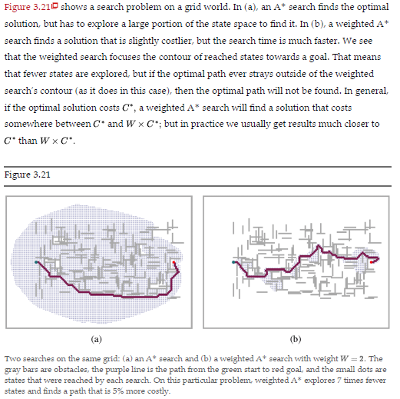
Weighted A*search
Example

Slide 47
Weighted A*search
We have considered searches that evaluate states by combining g and h in various ways;
Weighted A* can be seen as a generalization of the others:
A* search: g(n) + h(n) (W = 1)
Uniform-cost search: g(n) (W = 0)
Greedy best-first search: h(n) (W = ∞)
Weighted A* search: g(n) +W × h(n) (1 < W < ∞)

Slide 48
Weighted A*search
Weighted A* is “somewhat-greedy search”: like greedy best-first search, it focuses the search towards a goal; on the other hand, it won’t ignore the path cost completely, and will suspend a path that is making little progress at great cost.
There are a variety of suboptimal search algorithms, which can be characterized by the riteria for what counts as “good enough”.
In bounded suboptimal search, we look for a solution that is guaranteed to be within a constant factor of the optimal cost.
Weighted A* provides this guarantee.
In bounded-cost search, we look for a solution whose cost is less than some constant C
And in unbounded-cost search, we accept a solution of any cost, as long as we can find it quickly.
An example of an unbounded-cost search algorithm is speedy search, which is a version of greedy best-first search that uses as a heuristic the estimated number of actions required to reach a goal, regardless of the cost of those actions.
Thus, for problems where all actions have the same cost it is the same as greedy best-first search, but when actions have different costs, it tends to lead the search to find a solution quickly, even if it might have a high cost.

Slide 49
Memory-bounded search
The main issue with A* is its use of memory.
Memory is split between the frontier and the reached states
Algorithms for efficient memory ulitization
Beam Search
Iterative Deepening A*

Slide 50
Beam search
Beam search limits the size of the frontier.
The easiest approach is to keep only the nodes with the best f-scores, discarding any other expanded nodes.
This of course makes the search incomplete and suboptimal, but we can choose to make good use of available memory, and the algorithm executes fast because it expands fewer nodes.
For many problems it can find good near-optimal solutions.
An alternative version of beam search doesn’t keep a strict limit on the size of the frontier but instead keeps every node whose f-score is within δ of best f-score.

Slide 51
Iterative-deepening A* search
Iterative-deepening A* search (IDA*) is to A* what iterative-deepening search is to depth first
IDA* gives us the benefits of A* without the requirement to keep all reached states in memory, at a cost of visiting some states multiple times.
It is a very important and commonly used algorithm for problems that do not fit in memory.

Slide 52
Iterative-deepening A* search
In standard iterative deepening the cutoff is the depth, which is increased by one each iteration.
In IDA* the cutoff is the fcost (g+h); at each iteration, the cutoff value is the smallest fcost of any node that exceeded the cutoff on the previous iteration.

Slide 53
Recursive best-first search (RBFS)
Recursive best-first search (RBFS) attempts to mimic the operation of standard best-first search,
In a linear space.
RBFS resembles a recursive depth first search, but rather than continuing indefinitely down the current path.
It uses the f_limit variable to keep track of the f-value of the best alternative path available from any ancestor of the current node.
If the current node exceeds this limit, the recursion unwinds back to the alternative path.
As the recursion unwinds, RBFS replaces the f-value of each node along the path with a backed-up value—the best f-value of its children.
In this way, RBFS remembers the f-value of the best leaf in the forgotten subtree and can therefore decide whether it’s worth reexpanding the subtree at some later time.

Slide 54
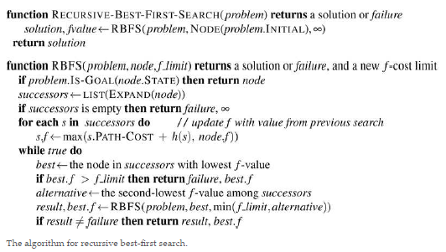
Recursive best-first search (RBFS)
Algorithm

Slide 55
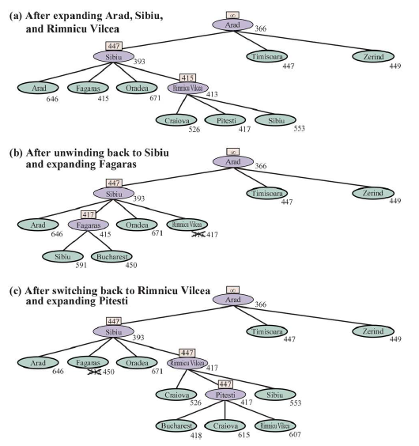
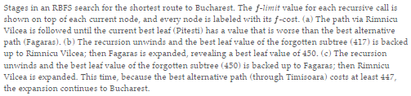
Recursive best-first search (RBFS) Example

Slide 56
Simplified Memory-bounded A*(SMA*)
IDA* and RBFS regenerates many node.
MA* (memory-bounded A*) and SMA* (simplified MA*)
SMA* proceeds just like A*, expanding the best leaf until memory is full.
At this point, it cannot add a new node to the search tree without dropping an old one.
SMA* always drops the worst leaf node—the one with the highest -value.
Like RBFS, SMA* then backs up the value of the forgotten node to its parent.
In this way, the ancestor of a forgotten subtree knows the quality of the best path in that subtree.
With this information, SMA* regenerates the subtree only when all other paths have been shown to look worse than the path it has forgotten.

Slide 57
Bidirectional heuristic search
With unidirectional best-first search, we saw that using as the evaluation f(n) = g(n) + h(n) function gives us an A* search that is guaranteed to find optimal-cost solutions (assuming h an admissible ) while being optimally efficient in the number of nodes expanded.
With bidirectional best-first search we could also try using but unfortunately there is no guarantee that this would lead to an optimal-cost solution, nor that it would be optimally efficient, even with an admissible heuristic.
With bidirectional search, it turns out that it is not individual nodes but rather pairs of nodes (one from each frontier) that can be proved to be surely expanded, so any proof of efficiency will have to consider pairs of nodes
We use f_{F} (n) = g_{F} (n) + h_{F} (n), for nodes going in the forward direction (with the initial state as root) and
for nodes in the backward direction f_{B}(n) = g_{B}(n) + h_{B}(n) (with a goal state as root).
Although both forward and backward searches are solving the same problem, they have different evaluation functions because, for example, the heuristics are different depending on whether we are striving for the goal or for the initial state.

Slide 58
Bidirectional heuristic search
Consider a forward path from the initial state to a node m and a backward path from the goal to a node n.
We can define a lower bound on the cost of a solution that follows the path from the initial state to m then somehow gets to n, then follows the path to the goal as
lb(m, n) = max(g_{F} (m) + g_{B}(n), f_{F} (m), f_{B}(n))
cost of such a path must be at least as large as the sum of the path costs of the two parts and
the cost must also be at least as much as the estimated cost of either part (because the heuristic estimates are optimistic).

Slide 59
Bidirectional heuristic search
Given that, the theorem is that for any pair of nodes m, n with lb(m, n) less than the optimal cost C* we must expand either m or n because the path that goes through both of them is a potential optimal solution.
The difficulty is that we don’t know for sure which node is best to expand, and therefore no bidirectional search algorithm can be guaranteed to be optimally efficient
Any algorithm might expand up to twice the minimum number of nodes if it always chooses the wrong member of a pair to expand first.
Some bidirectional heuristic search algorithms explicitly manage a queue of pairs.
But with bidirectional best-first search which has two frontier priority queues, and give it an evaluation function that mimics the criteria:
f₂(n) = max(2g(n), g(n) + h(n))

Slide 60
Bidirectional heuristic search
Given f₂(n) = max(2g(n), g(n) + h(n))
The node to expand next will be the one that minimizes this f₂value
the node can come from either frontier.
This f₂function guarantees that we will never expand a node with g(n) > C*/2(from either frontier)
We say the two halves of the search “meet in the middle” in the sense that when the two frontiers touch, no node inside of either frontier has a path cost greater than the bound

Slide 61
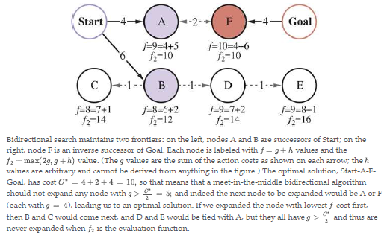
Bidirectional heuristic search
Example:

Slide 62
Bidirectional heuristic search
We have described an approach where the heuristic estimates the distance to the goal (or, when the problem has multiple goal states, the distance to the closest goal) and estimates the distance to the start.
This is called a front-to-end search.
An alternative, called front-to-front search, attempts to estimate the distance to the other frontier.
Clearly, if a frontier has millions of nodes, it would be inefficient to apply the heuristic function to every one of them and take the minimum.
But it can work to sample a few nodes from the frontier.
In certain specific problem domains it is possible to summarize the frontier—for example, in a grid search problem, we can incrementally compute a bounding box of the frontier, and use as a heuristic ,the distance to the bounding box.

Slide 63
Bidirectional heuristic search
Bidirectional search is sometimes more efficient than unidirectional search, sometimes not.
In general,
if we have a very good heuristic, then A* search produces search contours that are focused on the goal, and adding bidirectional search does not help much.
With an average heuristic, bidirectional search that meets in the middle tends to expand fewer nodes and is preferred.
In the worst case of a poor heuristic, the search is no longer focused on the goal, and bidirectional search has the same asymptotic complexity as A*.
Bidirectional search with the evaluation function and an admissible heuristic is complete and optimal.

Slide 64
Other References
https://en.wikipedia.org/wiki/Best-first_search
https://www.javatpoint.com/ai-informed-search-algorithms

